Slide 1
Introduction
Any physical control system inherently suffers steady-state error in response to certain types of inputs.
A system may have no steady-state error to a step input, but the same system may exhibit nonzero steady-state error to a ramp input.
Whether a given system will exhibit steady-state error for a given type of input depends on the type of open-loop transfer function of the system.

Slide 2
Classification of Control Systems
Control systems may be classified according to their ability to follow step inputs, ramp inputs, parabolic inputs, and so on.
The magnitudes of the steady-state errors due to these individual inputs are indicative of the goodness of the system.

Slide 3
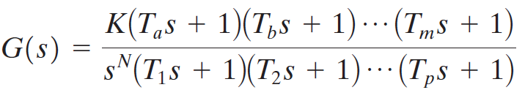
Classification of Control Systems
Consider the unity-feedback control system with the following open-loop transfer function
It involves the term s^{N} in the denominator, representing N poles at the origin.
A system is called type 0, type 1, type 2, ... , if N=0, N=1, N=2, ... , respectively.

Slide 4
Classification of Control Systems
As the type number is increased, accuracy is improved.
However, increasing the type number aggravates the stability problem.
A compromise between steady-state accuracy and relative stability is always necessary.

Slide 5
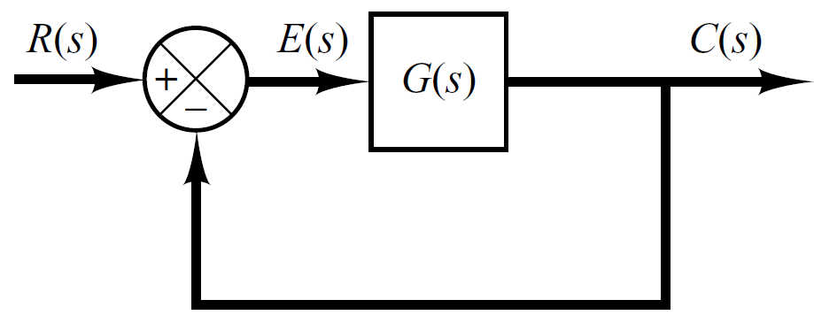

Steady State Error of Unity Feedback Systems
Consider the system shown in following figure.
The closed-loop transfer function is

Slide 6

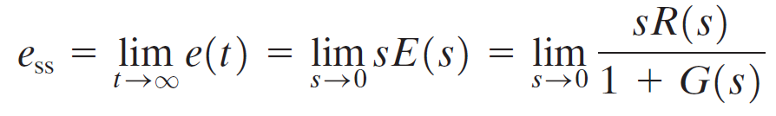
Steady State Error of Unity Feedback Systems
The transfer function between the error signal E(s) and the input signal R(s) is
The final-value theorem provides a convenient way to find the steady-state performance of a stable system.
Since E(s) is
The steady state error is

Slide 7
Static Error Constants
The static error constants are figures of merit of control systems. The higher the constants, the smaller the steady-state error.
In a given system, the output may be the position, velocity, pressure, temperature, or the like.
Therefore, in what follows, we shall call the output “position,” the rate of change of the output “velocity,” and so on.
This means that in a temperature control system “position” represents the output temperature, “velocity” represents the rate of change of the output temperature, and so on.

Slide 8
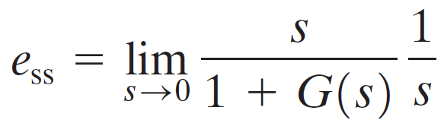
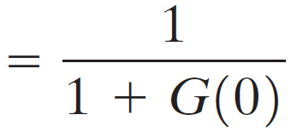
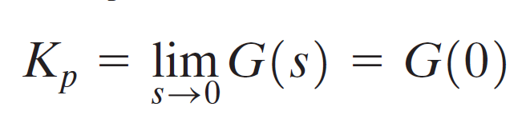
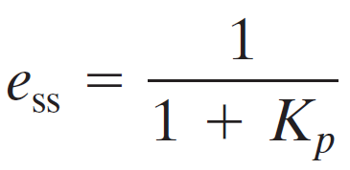
Static Position Error Constant (K_{p})
The steady-state error of the system for a unit-step input is
The static position error constant K_{p} is defined by
Thus, the steady-state error in terms of the static position error constant K_{p} is given by

Slide 9
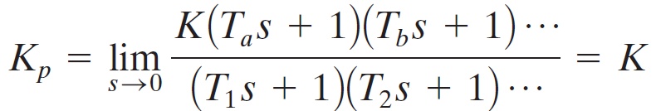
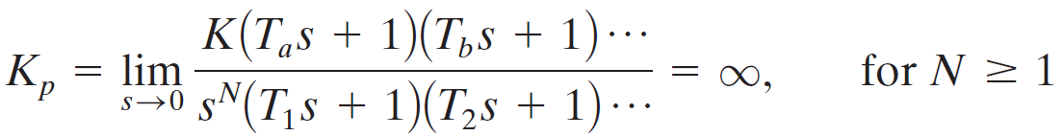
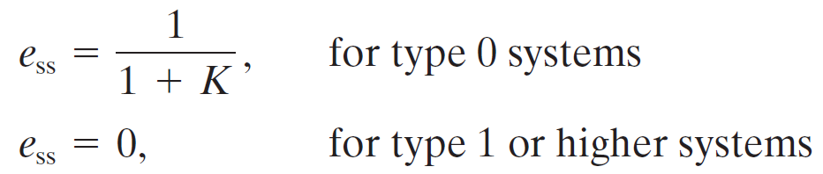
Static Position Error Constant (K_{p})
For a Type 0 system
For Type 1 or higher systems
For a unit step input the steady state error e_{ss} is

Slide 10
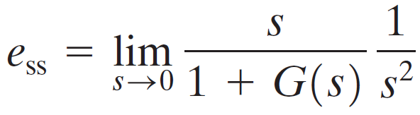
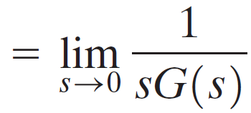

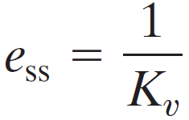
Static Velocity Error Constant (K_{v})
The steady-state error of the system for a unit-ramp input is
The static position error constant K_{v} is defined by
Thus, the steady-state error in terms of the static velocity error constant K_{v} is given by

Slide 11
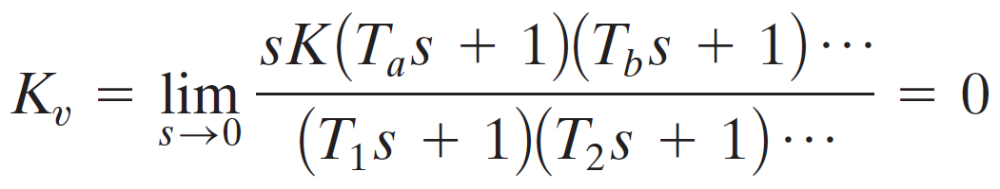
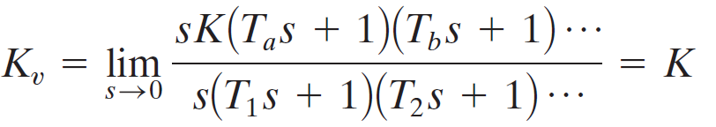
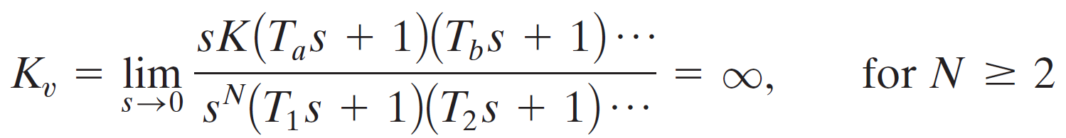
Static Velocity Error Constant (K_{v})
For a Type 0 system
For Type 1 systems
For type 2 or higher systems

Slide 12
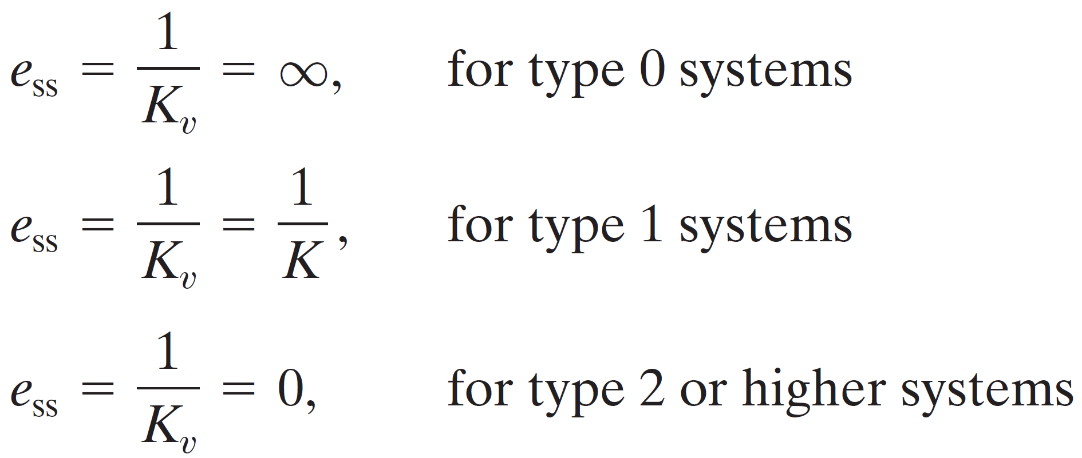
Static Velocity Error Constant (K_{v})
For a ramp input the steady state error e_{ss} is

Slide 13
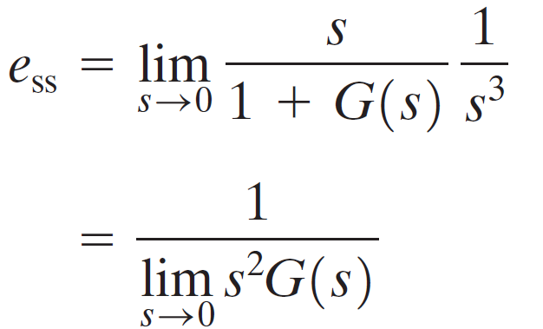
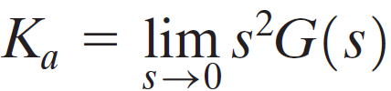
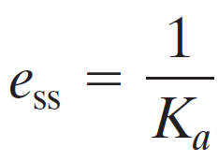
Static Acceleration Error Constant (K_{a})
The steady-state error of the system for parabolic input is
The static acceleration error constant K_{a} is defined by
Thus, the steady-state error in terms of the static acceleration error constant K_{a} is given by

Slide 14

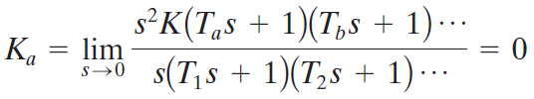
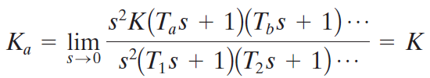
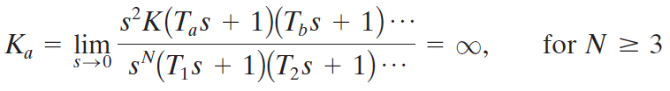
Static Acceleration Error Constant (K_{a})
For a Type 0 system
For Type 1 systems
For type 2 systems
For type 3 or higher systems

Slide 15
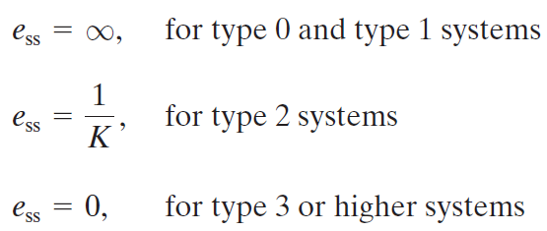
Static Acceleration Error Constant (K_{a})
For a parabolic input the steady state error e_{ss} is

Slide 16
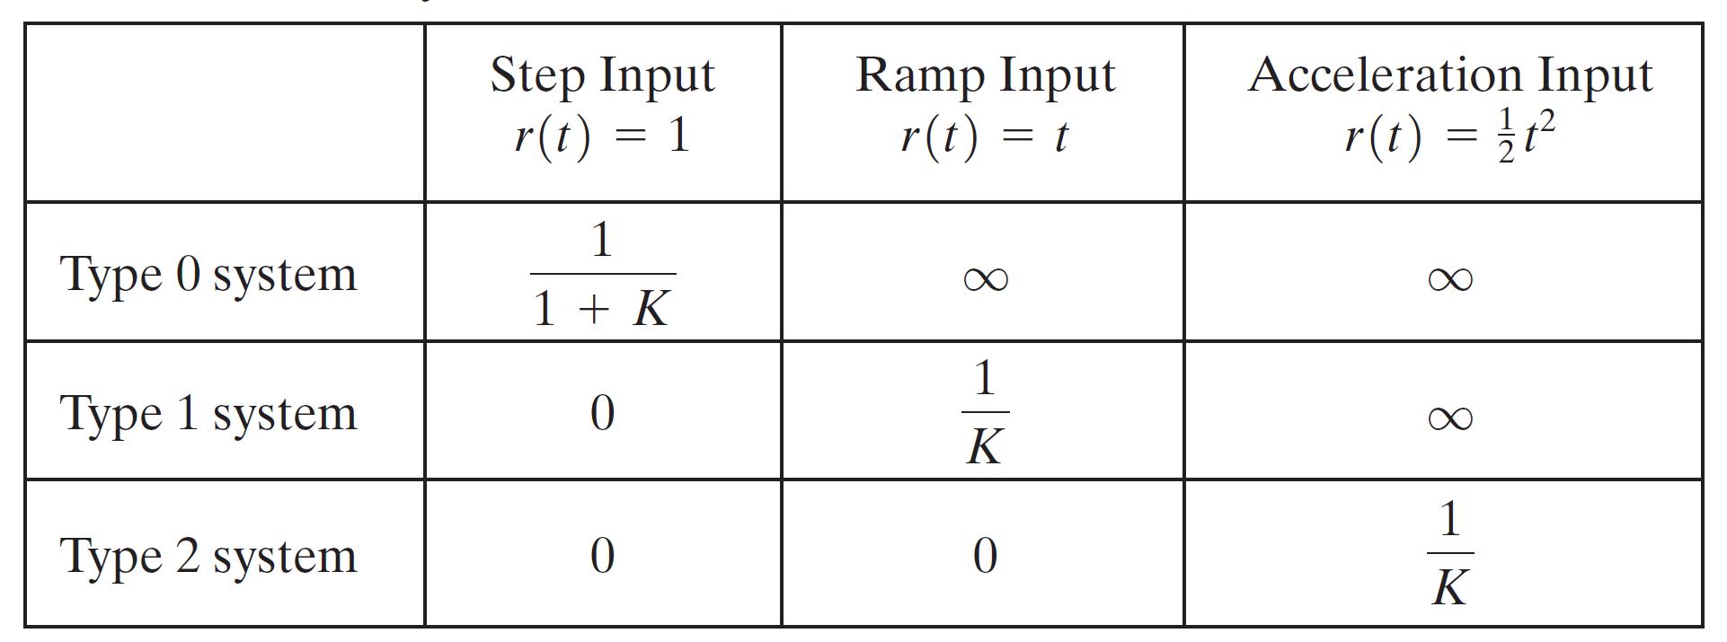
Summary

Slide 17
Example#1
For the system shown in figure below evaluate the static error constants and find the expected steady state errors for the standard step, ramp and parabolic inputs.
R(S)
C(S)
-

Slide 18
Example#1 (evaluation of Static Error Constants)

Slide 19
Example#1 (Steady Sate Errors)

